Slide 1


Janki Rathod
13 march 2024

Slide 2

Outline
Executive Summary
Introduction
Methodology
Results
Conclusion
Appendix

Slide 3
Executive Summary
Summary of methodologies
Data Collection using API & Web Scrapping
Data Wrangling
Exploratory Data analysis using SQL & Visualization
Interactive visualization using Folium and Plotly
Predictive Analysis using various Classification algorithm
Summary of all results
The best hyper parameters for Logistic Regression, SVM, Decision Tree and KNN Classifier
Best method that has highest performance

Slide 4
Introduction
Project background and context
Space Y is to compete with Space X and other space agencies. Space Y mission is to make rocket launches relatively inexpensive for everyone. Space X have significtly reduced the price of rocket launch from $110 million to $65 million by using reusing first stage of recket. Space Y want to observe data of Space X and drive meaningful insigts in order to answer below questions.
Problems you want to find answers
Determining price of each rocket launch?
Determine if the first stage of rocket will land successfully or not?

Slide 5

Section 1

Slide 6
Methodology
Executive Summary
Data collection methodology:
Space X Rest API
Using web scraping from Wikipedia.
Perform data wrangling
The data collected was in JSON and HTML format, data was converted into Pandas data frame for visualization and analysis
Perform exploratory data analysis (EDA) using visualization and SQL
Perform interactive visual analytics using Folium and Plotly Dash
Perform predictive analysis using classification models
Using machine learning models to determine id the first stage of Falcon 9 will land successfully or not.
Data is split into training data and test data to find the best Hyper parameter for SVM, Classification Trees, and Logistic Regression. Then find the method that performs best using test data.

Slide 7
Data Collection
The information obtained by the API are rocket, launches, payloadinformation.
Space X REST API URL: api.spacexdata.com/v4/
The information obtained by the web scrapping of Wikipedia are launches, landing, payload information.
URL: https://en.wikipedia.org/w/index.php?title=List_of_Falcon_9_and_Falcon_Heavy_launches&oldid=1027686922
Space X Rest API Request
JSON Object as Response
Convert JSON object to DataFrame
Clean & Format Data
Export Data
Get HTML response from Wikipedia
Use BeautifulSoup to extract data
Parse Table data
Convert Table data into DataFrame
Export Data

Slide 8
Data Collection – SpaceX API
Setting up API Endpoint to send request
Converting JSON object into Dataframe
Extract features from dataframe
Get past launch data as JSON object and convert to Dataframe
Filter Dataframe to only include Falcon 9 Launches
Deal with missing values
Export to file
Saving response from API call
Data Collection API notebook

Slide 9
Data Collection - Scraping
Request URL for Falcon 9 Wikipedia page
Using BeautifulSoup extract response
Find all the columns from HTML table
Create Dataframe by parsing HRML table
Export data
Web Scrapping notebook

Slide 10
Data Wrangling
Field “Outcome” represent the classification variable that represents the outcome of each launch.
If the value is zero, the first stage did not land successfully
one means the first stage landed Successfully
Load SpaceX dataset
Identify Missing values
Identify which columns are numerical and categorical:
Calculate the number of launches on each site
Calculate the number and occurrence of each orbit
Calculate the number and occurrence of mission outcome per orbit type
Create a landing outcome label from Outcome column
Data Wrangling notebook

Slide 11
EDA with Data Visualization
Cat Plot
Bar Chart
Line Chart
Relationship between Flight Number and Payload
Relationship between Flight Number and Launch
Relationship between Payload and Launch Site
Relationship between Flight Number and Orbit type
Relationship between Payload and Orbit type
To visualize Success rate of each Orbit
To visualize launch site yearly trend
EDA with Data Visualization notebook

Slide 12
EDA with SQL
SQL Queries
Displaying the names of the unique launch sites in the space mission
Displaying 5 records where launch sites begin with the string 'CCA'
Displaying the total payload mass carried by boosters launched by NASA (CRS)
Displaying average payload mass carried by booster version F9 v1.1
Listing the date when the first successful landing outcome in ground pad was achieved.
Listing the names of the boosters which have success in drone ship and have payload mass greater than 4000 but less than 6000
Listing the total number of successful and failure mission outcomes
Listing the names of the booster versions which have carried the maximum payload mass. Use a subquery
Listing the records which will display the month names, failure landing outcomes in drone ship ,booster versions, launch site for the months in year 2015.
Ranking the count of landing outcomes (such as Failure (drone ship) or Success (ground pad)) between the date 2010-06-04 and 2017-03-20, in descending order.
EDA with SQL notebook

Slide 13
Build an Interactive Map with Folium
Folium map object is a map centered on NASA Johnson Space Center at Houson, Texas
Folium.Circle & folium.Marker are used to add red marker with a text labels on specific coordinate for each launch site on map.
MarketCluster object is used for grouping of points in a cluster to display multiple and different information for the same coordinates
Folium.Icon is used to show successful and unsuccessful landings. Green for successful landing and Red for unsuccessful landing.
Folium.PolyLine is used to draw a line between a launch site to its closest city, railway and highway
Interactive Maps Folium notebook

Slide 14
Build a Dashboard with Plotly Dash
Dashboard application contains input components such as a dropdown list and a range slider to interact with a pie chart and a scatter point chart.
Launch Site Drop-down allows use to select site.
Pie chart shows count of total success and total failure for the selected launch site.
Range Slider to allows user to select Payload mass in given range.
Scatter chart shows the relationship between two variables, in particular Success vs Payload Mass.
Plotly notebook

Slide 15
Predictive Analysis (Classification)
Data preparation
Load dataset
Normalize data
Split data into training and test sets.
Model preparation
Selection of machine learning algorithms
Set parameters for each algorithm to GridSearchCV
Training GridSearchModel models with training dataset
Model evaluation
Get best hyperparameters for each type of model
Compute accuracy for each model with test dataset
Plot Confusion Matrix
Model comparison
Comparison of models according to their accuracy
The model with the best accuracy will be chosen (see Notebook for result)
Predictive Analysis notebook

Slide 16
Results
Exploratory data analysis results
Interactive analytics demo in screenshots
Predictive analysis results

Slide 17

Section 2

Slide 18
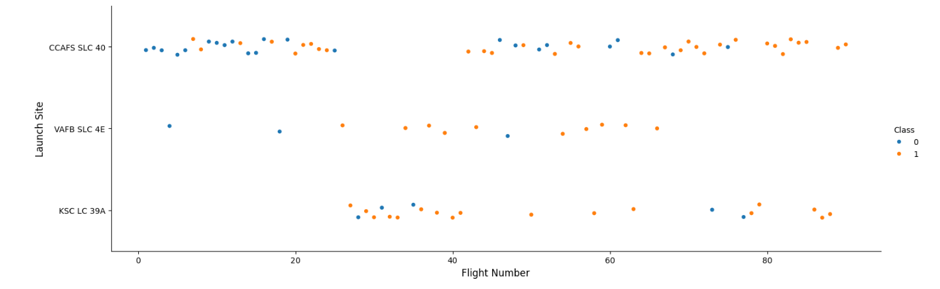
Flight Number vs. Launch Site
Scatter plot of Flight Number vs. Launch Site
We can see that with time the success rate has increased specially for CCAFS SLC 40 site.
VAFB SLC 4E has lowest number of launches.

Slide 19
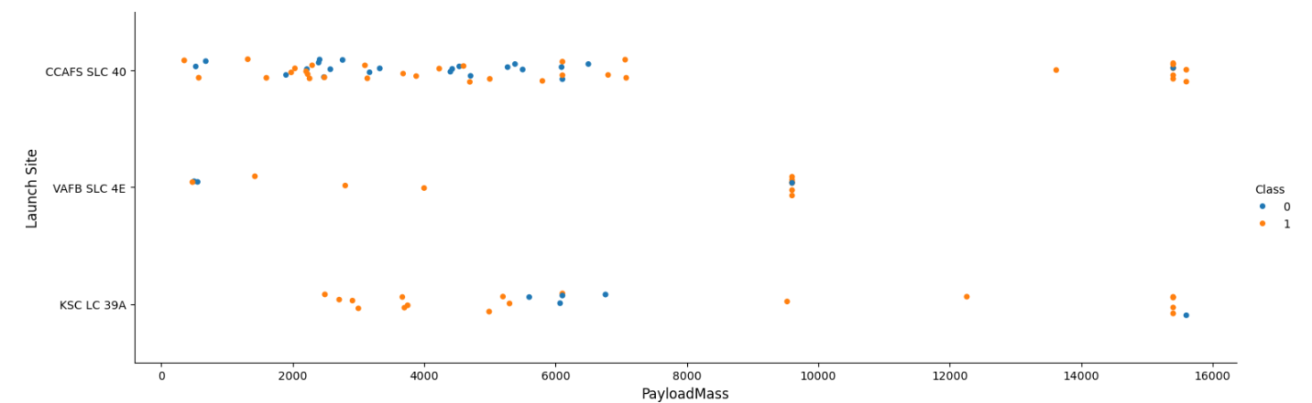
Payload vs. Launch Site
Satter plot of Payload vs. Launch Site
Increase in payload mass suggest more success rate
@VAFB SLC 4E no rocket launched for heavy payload mass
@CCAFS SLC launched rockets were less than 7500kg and more than 13000kg payload mass but not in-between

Slide 20
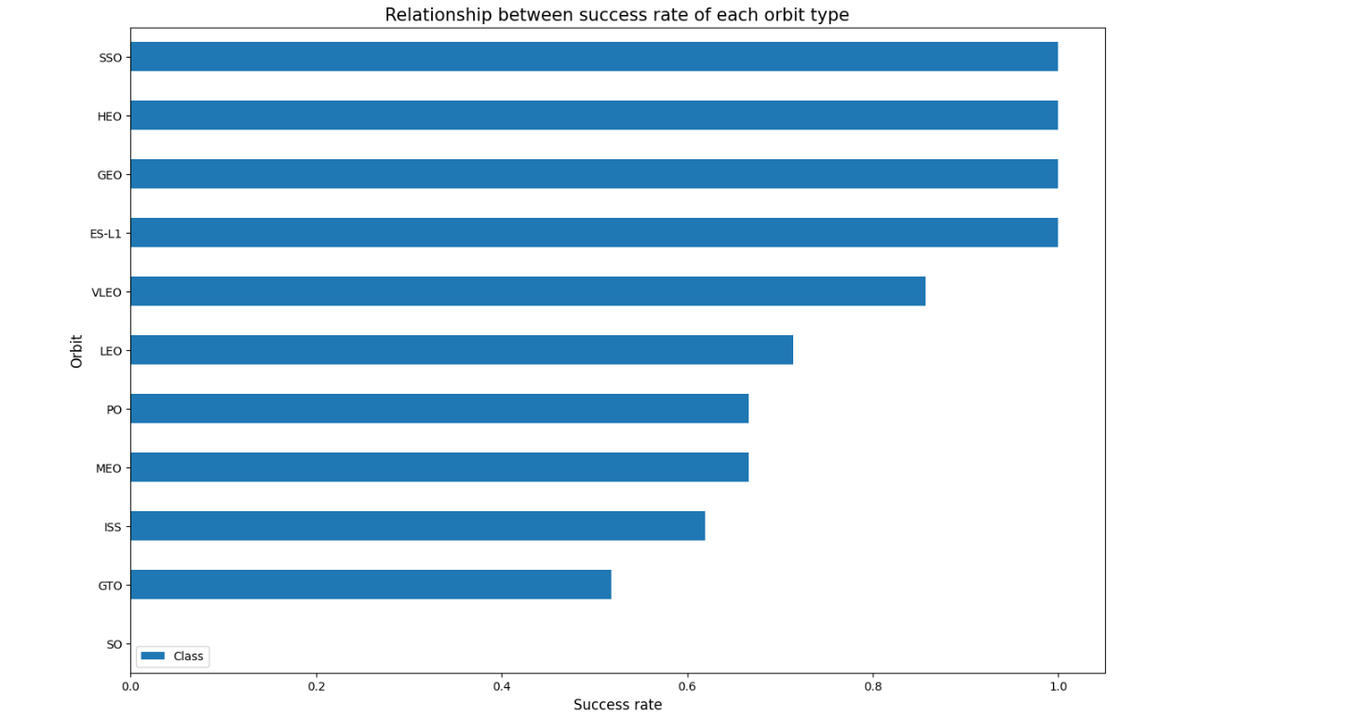
Success Rate vs. Orbit Type
A bar chart for the success rate of each orbit type
With this plot, we can see success rate for different orbit types. We note that ES-L1, GEO, HEO, SSO have the best success rate.

Slide 21
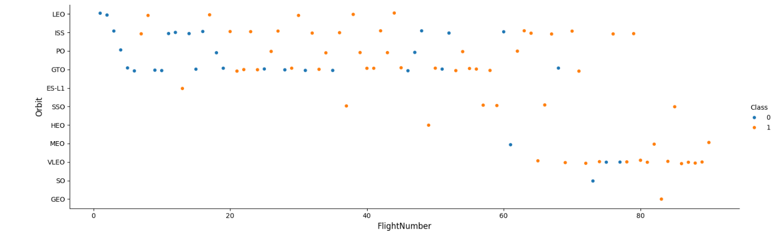
Flight Number vs. Orbit Type
Scatter point of Flight number vs. Orbit type
GTO and ISS orbits has the higher concentration of launches with the lowest ration of successful landings.
The orbits with higher successful rate, has one or just few number of launches

Slide 22
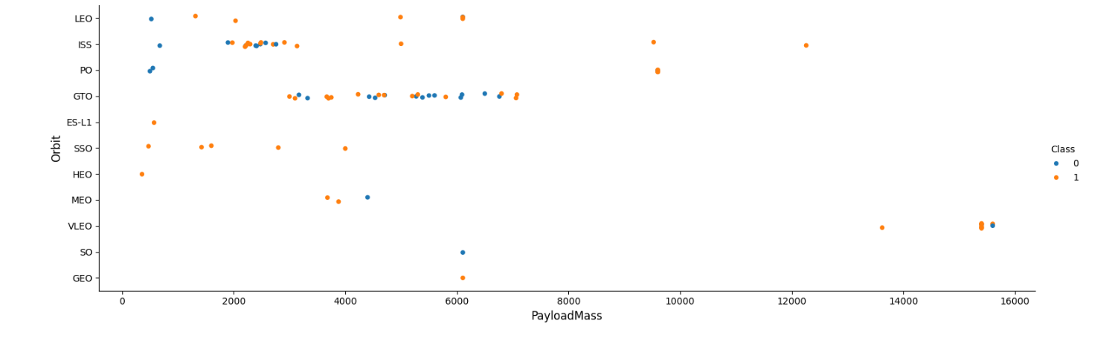
Payload vs. Orbit Type
Scatter point of payload vs. orbit type
The weight of the payloads can have a great influence on the success rate of the launches in certain orbits. For example, heavier payloads improve the success rate for the LEO orbit.
Decreasing the payload weight for a GTO orbit improves the success of a launch.

Slide 23
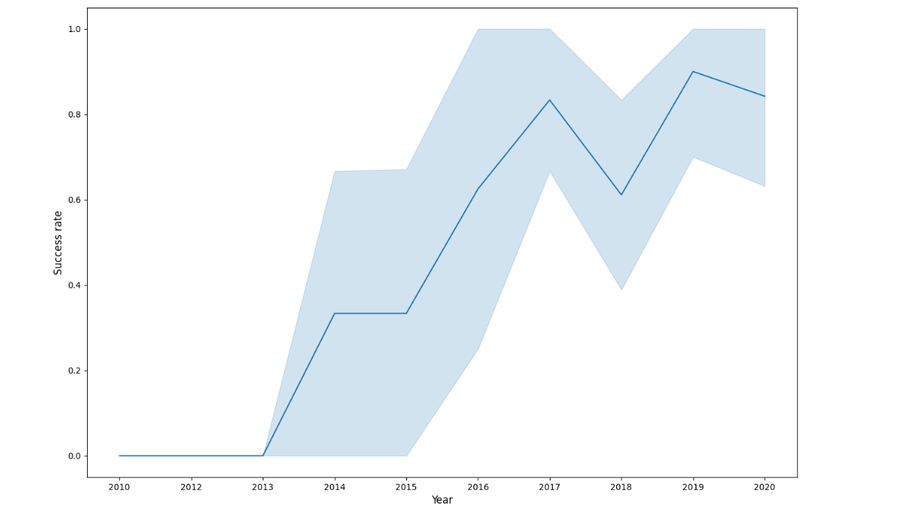
Launch Success Yearly Trend
Show a line chart of yearly average success rate
Success rate kept on increasing since 2013.

Slide 24
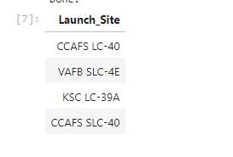
All Launch Site Names
Names of the unique launch sites.
Present your query result with a short explanation here
%sql SELECT DISTINCT "LAUNCH_SITE" FROM SPACEXTBL
Distinct removes the duplicate value

Slide 25
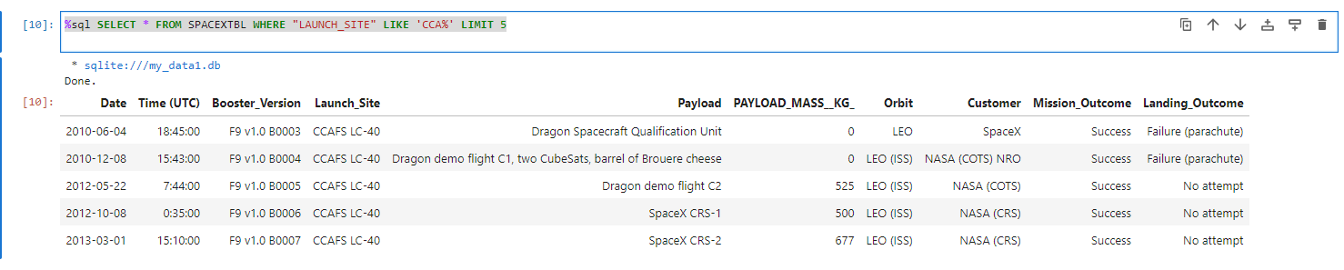
Launch Site Names Begin with 'CCA'
Find 5 records where launch sites begin with `CCA`
Present your query result with a short explanation here
%sql SELECT * FROM SPACEXTBL WHERE "LAUNCH_SITE" LIKE 'CCA%' LIMIT 5
Like operator in where clause allows us to filter record based on matching string
LIMIT 5 shows 5 records from filtering.

Slide 26
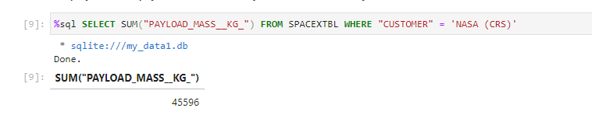
Total Payload Mass
Calculate the total payload carried by boosters from NASA
Present your query result with a short explanation here
%sql SELECT SUM("PAYLOAD_MASS__KG_") FROM SPACEXTBL WHERE "CUSTOMER" = 'NASA (CRS)‘
SUM function calculate the total.

Slide 27
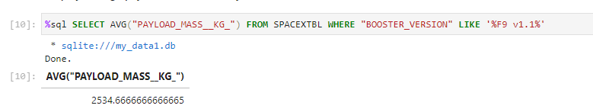
Average Payload Mass by F9 v1.1
Calculate the average payload mass carried by booster version F9 v1.1
Present your query result with a short explanation here
%sql SELECT AVG("PAYLOAD_MASS__KG_") FROM SPACEXTBL WHERE "BOOSTER_VERSION" LIKE '%F9 v1.1%‘
AVG function gives average

Slide 28
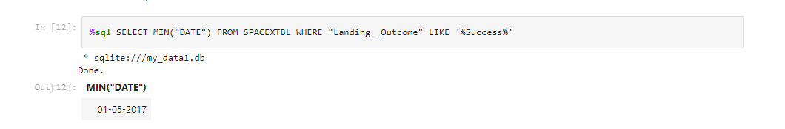
First Successful Ground Landing Date
Find the dates of the first successful landing outcome on ground pad
MIN function allows to select minimum value
%SQL SELECT MIN("DATE") FROM SPACEXTBL WHERE "Landing _Outcome" LIKE '%Success%'

Slide 29
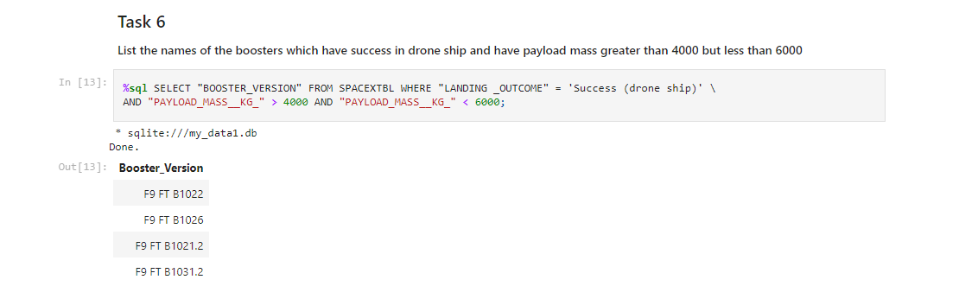
Successful Drone Ship Landing with Payload between 4000 and 6000
List the names of boosters which have successfully landed on drone ship and had payload mass greater than 4000 but less than 6000
AND clause in where query allows us to add multiple condition in where clause
%sql SELECT "BOOSTER_VERSION" FROM SPACEXTBL WHERE "LANDING _OUTCOME" = 'Success (drone ship)' AND "PAYLOAD_MASS__KG_" > 4000 AND "PAYLOAD_MASS__KG_" < 6000;

Slide 30
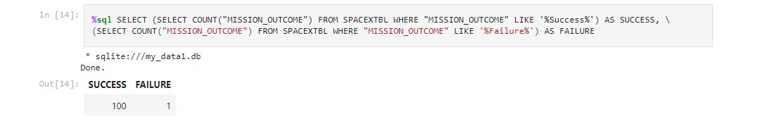
Total Number of Successful and Failure Mission Outcomes
Calculate the total number of successful and failure mission outcomes
%sql SELECT (SELECT COUNT("MISSION_OUTCOME") FROM SPACEXTBL WHERE "MISSION_OUTCOME" LIKE '%Success%') AS SUCCESS, (SELECT COUNT("MISSION_OUTCOME") FROM SPACEXTBL WHERE "MISSION_OUTCOME" LIKE '%Failure%') AS FAILURE
Count along with where query allows us to count specific values

Slide 31
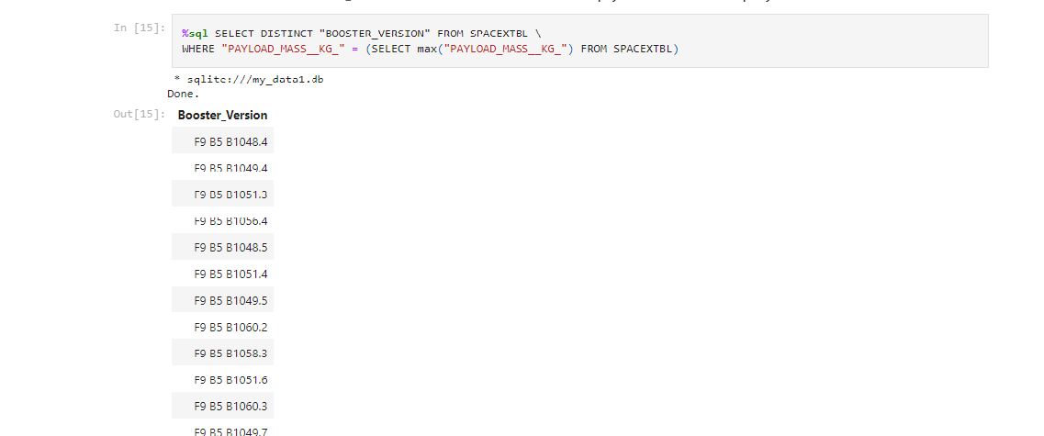
Boosters Carried Maximum Payload
List the names of the booster which have carried the maximum payload mass
%sql SELECT DISTINCT "BOOSTER_VERSION" FROM SPACEXTBL WHERE "PAYLOAD_MASS__KG_" = (SELECT max("PAYLOAD_MASS__KG_") FROM SPACEXTBL)
First finding the maxing payload mass and then using that maximum mass in where query gives desired output

Slide 32
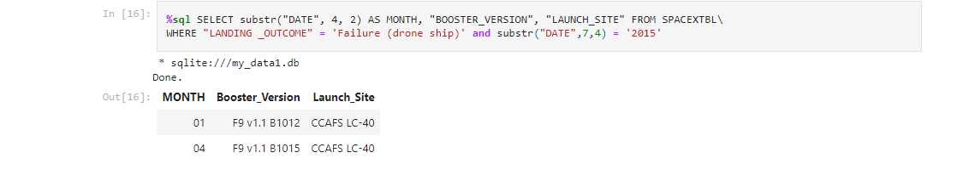
2015 Launch Records
List the failed landing_outcomes in drone ship, their booster versions, and launch site names for in year 2015
%sql SELECT substr("DATE", 4, 2) AS MONTH, "BOOSTER_VERSION", "LAUNCH_SITE" FROM SPACEXTBL WHERE "LANDING _OUTCOME" = 'Failure (drone ship)' and substr("DATE",7,4) = '2015‘
This query returns month, booster version, launch site where landing was unsuccessful and landing date took place in 2015. Substr function process date in order to take month or year. Substr(DATE, 4, 2) shows month. Substr(DATE,7, 4) shows year.

Slide 33
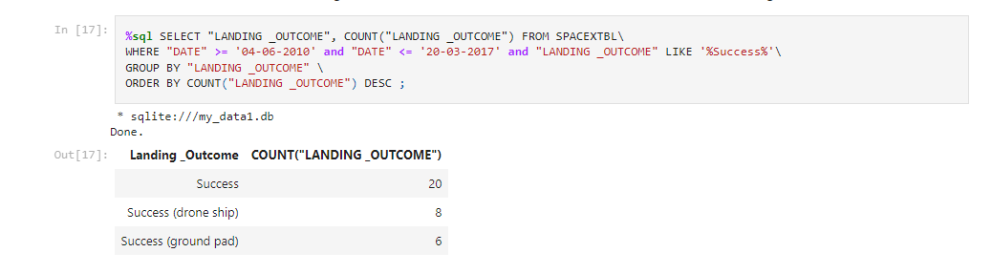
Rank Landing Outcomes Between 2010-06-04 and 2017-03-20
Rank the count of landing outcomes (such as Failure (drone ship) or Success (ground pad)) between the date 2010-06-04 and 2017-03-20, in descending order
This query returns landing outcomes and their count where mission was successful and date is between 04/06/2010 and 20/03/2017. The GROUP BY clause groups results by landing outcome and ORDER BY COUNT DESC shows results in decreasing order.

Slide 34

Section 3

Slide 35
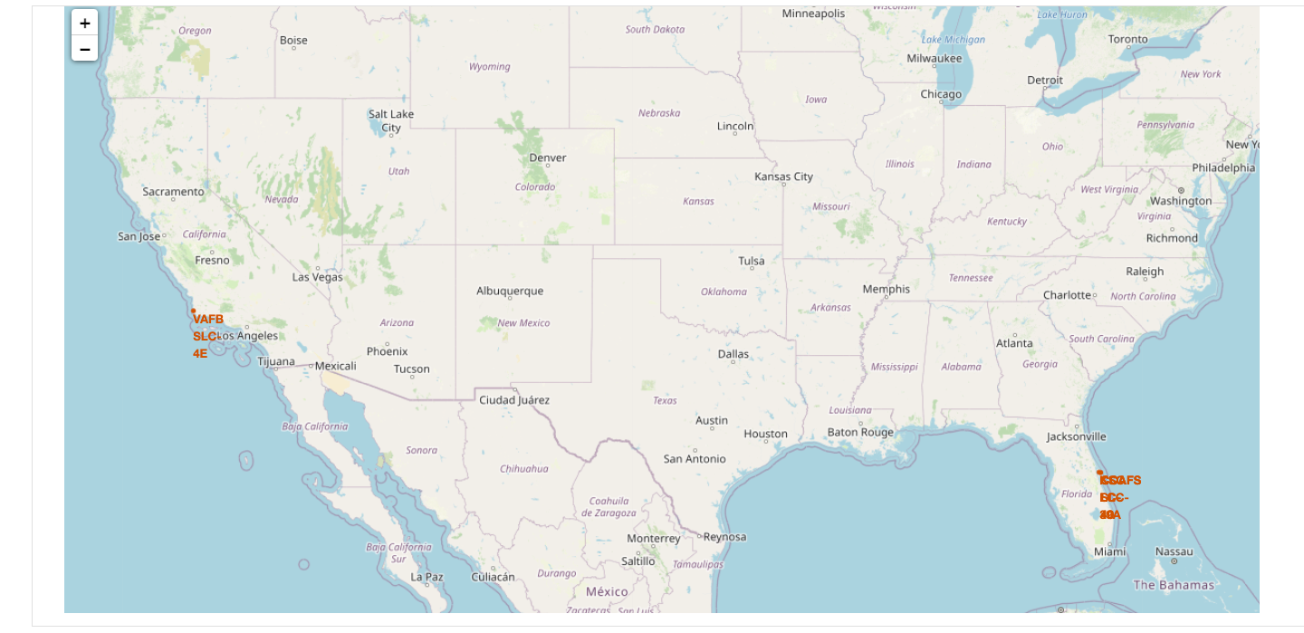
Space X Launch Sites
All the launch sites are located in coastal areas

Slide 36
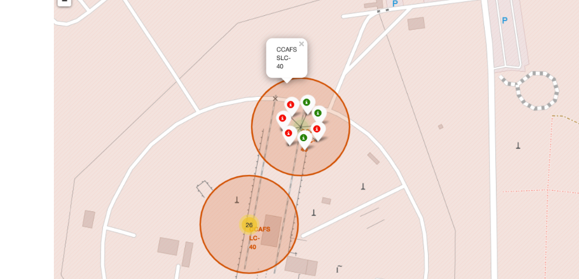
Labelled Marker – Success/Failure for site
Green marker shows successful launch and red marker shows failure

Slide 37
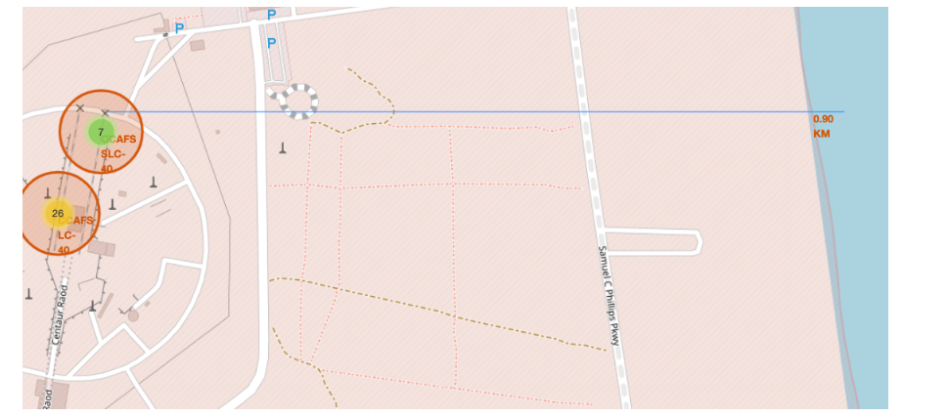
Launch site and its proximities
Launch sites are near to railways, roads, highways and coastline.

Slide 38

Section 4

Slide 39
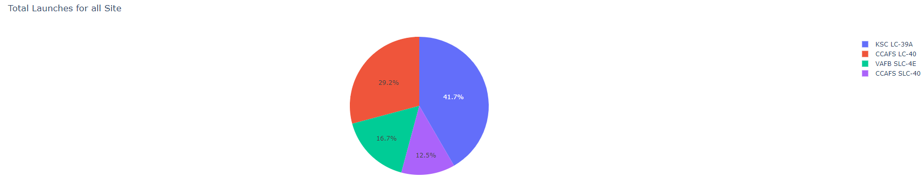
Total success Launches by Site
KSC LC-39A has the highest success rate of launches.

Slide 40
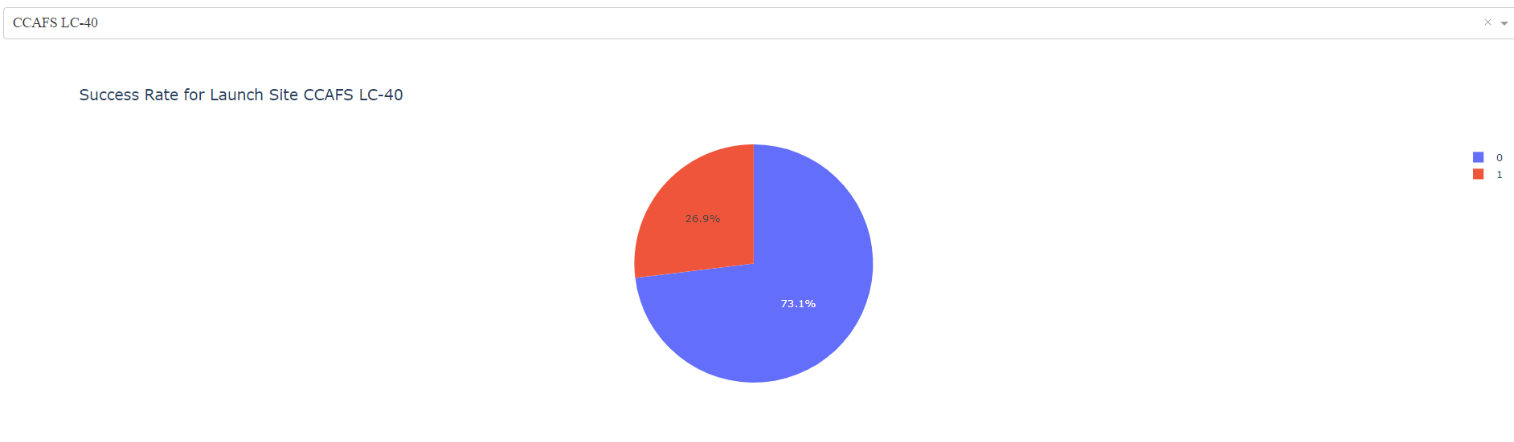
Total success launches for Site CCAFS LC-40
This site has 73.1% Success

Slide 41
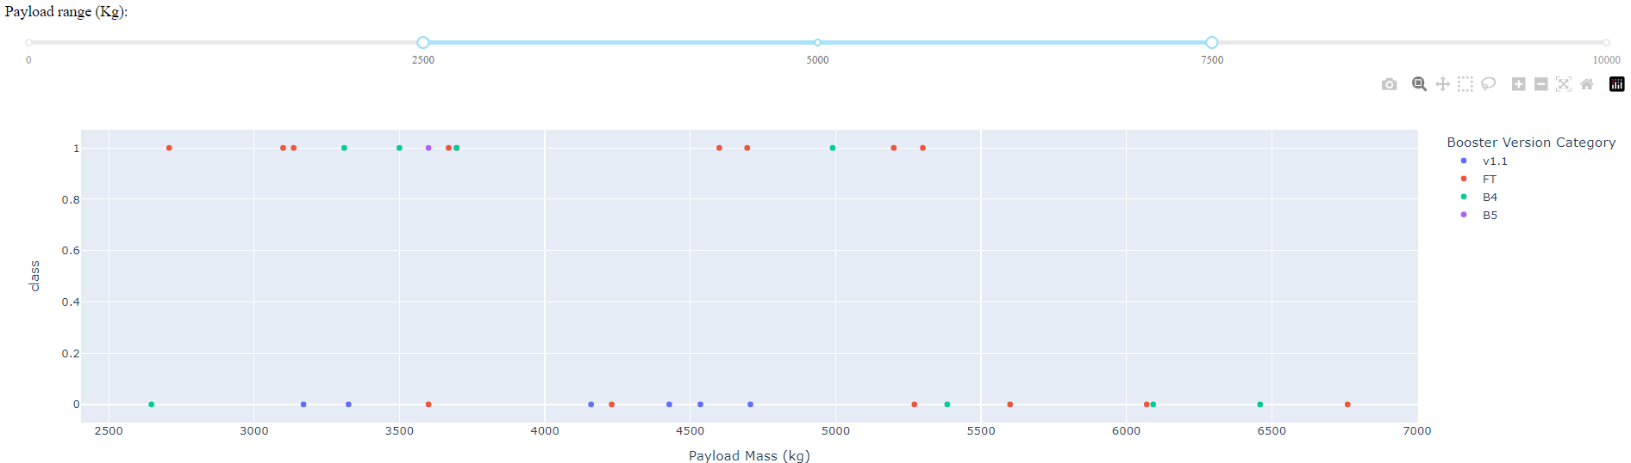
Payload mass vs Outcome for all sites for(2500kg-7500kg)
For given range low weighted payloads have a better success rate than the heavy weighted payloads.

Slide 42

Section 5

Slide 43
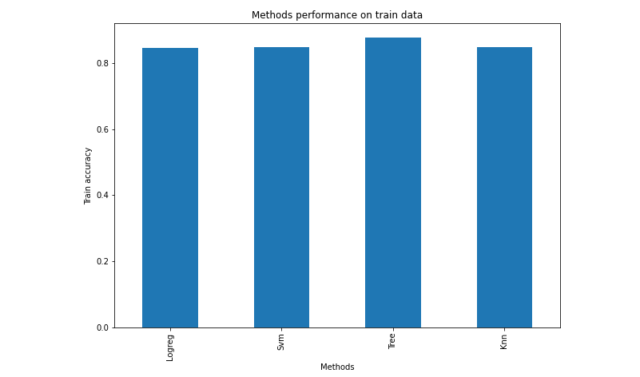
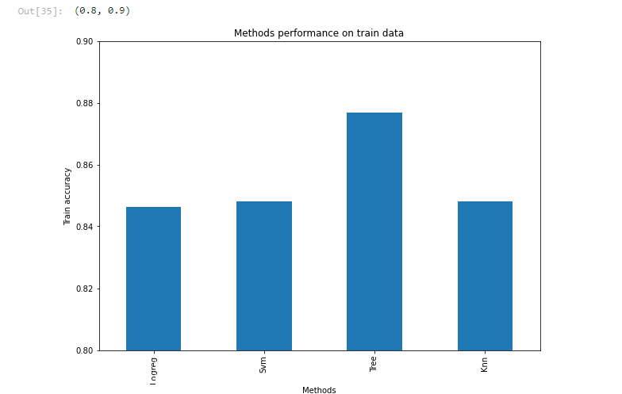
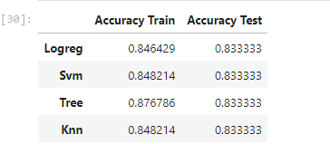
Classification Accuracy
For accuracy test, all methods performed similar. We could get more test data to decide between them. But if we really need to choose one right now, we would take the decision tree.

Slide 44
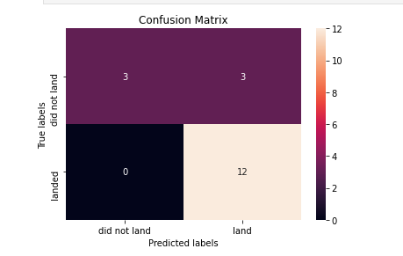
Confusion Matrix
As the test accuracy are all equal, the confusion matrices are also identical. The main problem of these models are false positives.

Slide 45
Conclusions
The effectiveness of a mission can be attributed to various elements including the launch location, the orbital trajectory, and notably, the frequency of prior launches. It is reasonable to infer that accumulated knowledge gained from previous launches contributes to the transition from launch failures to successful missions.
The orbital paths with the highest rates of success are Geostationary Earth Orbit (GEO), Highly Elliptical Orbit (HEO), Sun-Synchronous Orbit (SSO), and Earth-Sun Lagrange Point 1 (ES-L1).
In selecting the model for this dataset, we opt for the Decision Tree Algorithm as the preferred choice, despite all models yielding identical test accuracies. Our decision is based on the Decision Tree Algorithm exhibiting superior training accuracy compared.

Slide 46


